Slide 1
SNS ACADEMY
A fingerprint International School
Affiliated to CBSE New Delhi
Affiliation No :1930610
GRADE XII A (2020-21)
COURSE NAME :BIOLOGY (044)
Chapter-5 PRINCIPLES OF INHERITANCE – LINKAGE AND RECOMBINATION

Slide 3
Linkage – Definition
‘’Tendency of genes to remain together in their original combination during inheritance is called linkage. ‘’

Slide 4
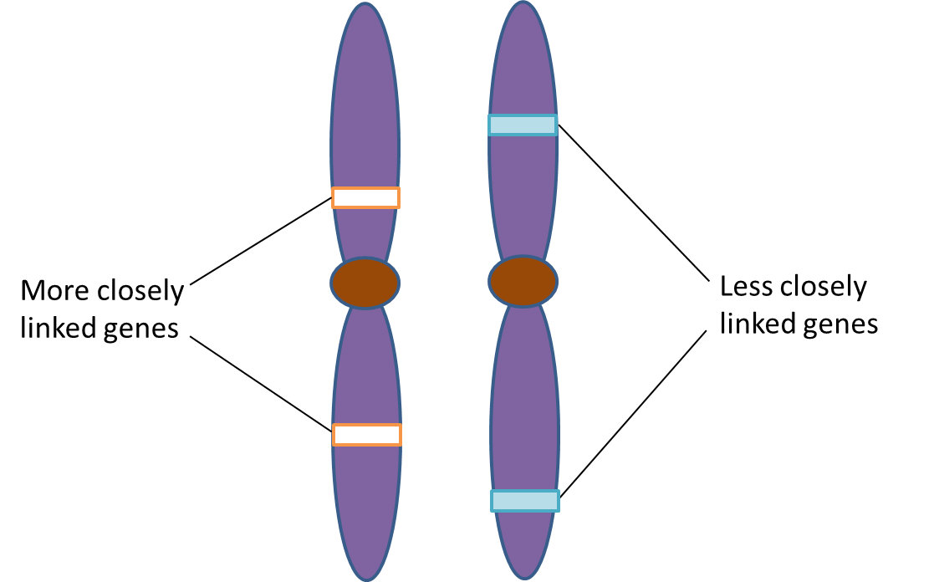
LINKAGE
Approximately 30000 genes were present in human.
A chromosome possesses many gene.
All genes present in a chromosome are inherited together.
Linked genes
Study of inheritance of these genes - linkage

Slide 5
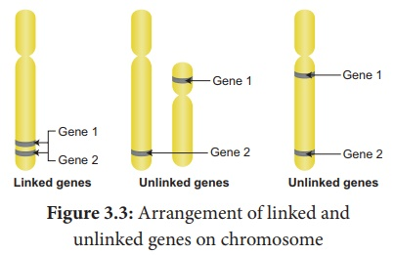
Diagram showing linkage

Slide 6
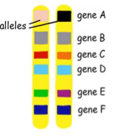
Bateson and Punnet Experiment
Dihybrid cross
Colour and shape of pollen in sweet pea
Did not follow the Mendelian law.
Law of independent assortment

Slide 7
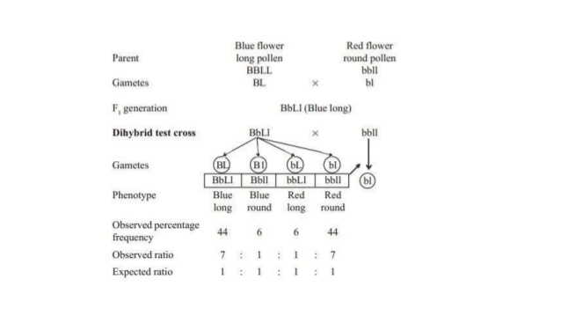

Slide 8
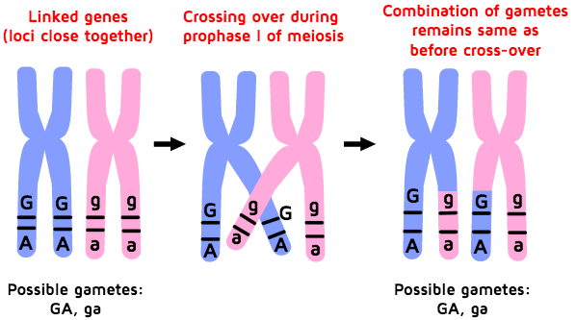
Coupling – Repulsion theory
Gene from same parent enter the gamete and inherited together is called coupling
Gene from separate parents enter into different gamete and inherited separately is called repulsion

Slide 10
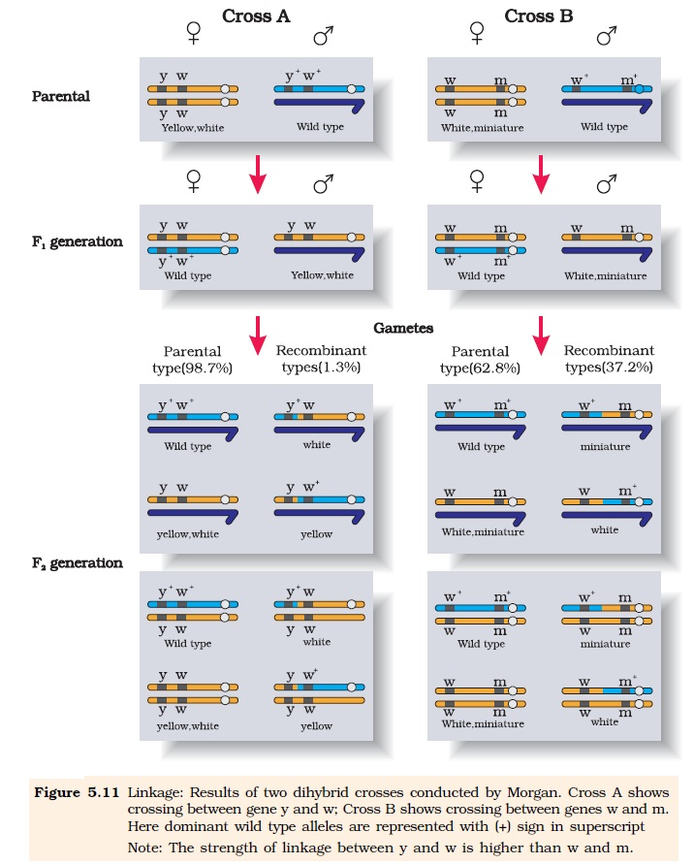

Slide 12
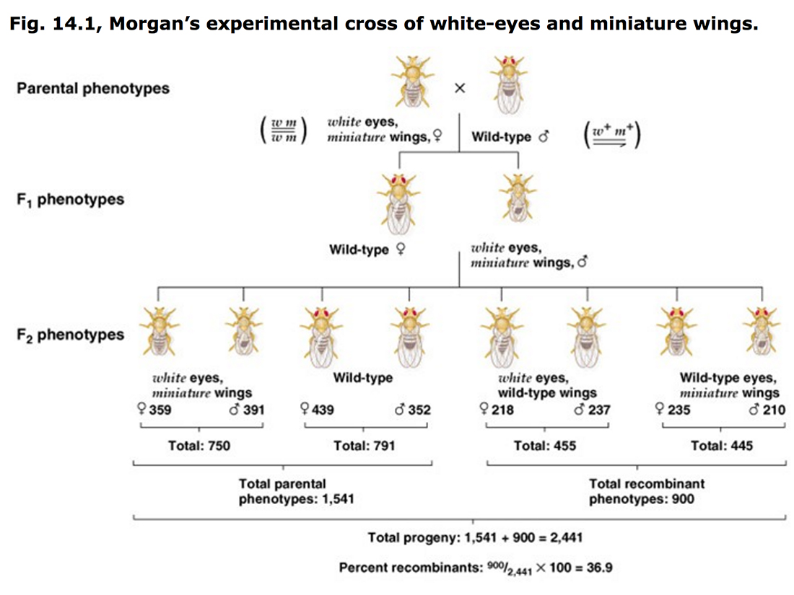

Slide 13
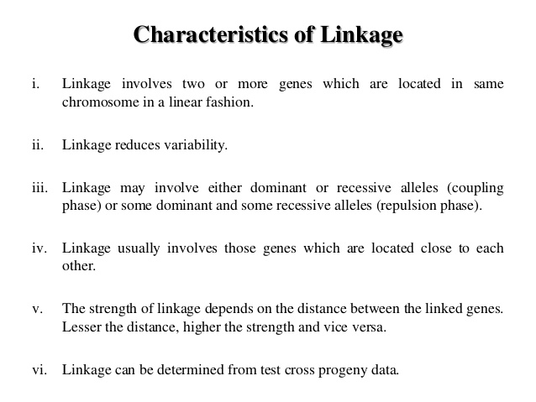

Slide 14
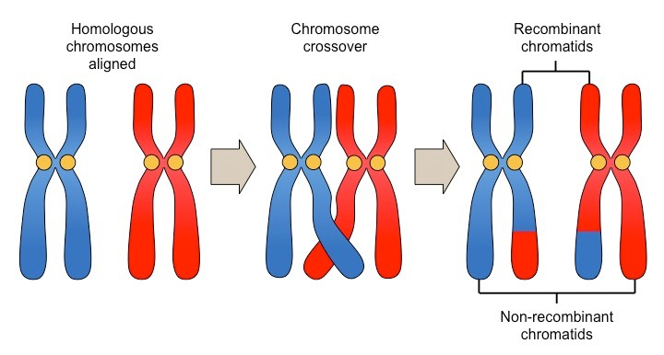
Recombination / crossing over
Pachytene stage of meiosis
Exchange of segments b/w non sister chromatids of homologues chromosomes.

